Slide 1
Linear Equations and Functions
Algebra 2
Chapter 2
Notes:
Algebra II 2

Slide 2
This Slideshow was developed to accompany the textbook
  Larson Algebra 2
  By Larson, R., Boswell, L., Kanold, T. D., & Stiff, L.
  2011 Holt McDougal
Some examples and diagrams are taken from the textbook.
Slides created by
Richard Wright, Andrews Academy
rwright@andrews.edu

Slide 3
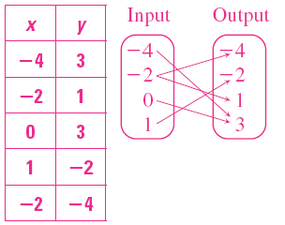
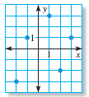
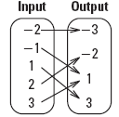
2.1 Represent Relations and Functions
Relation is mapping (pairing) of input values to output values
  Input → Domain → often x
  Output → Range → often y
(-4, 3)
(-2, 1)
(0, 3)
(1, -2)
(-2, 4)
Notes:
Ask domain and range questions for the relations

Slide 4
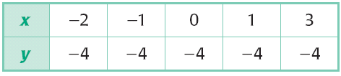
2.1 Represent Relations and Functions
Function
  Relation where each input has exactly one output
  Same x does not go to more than one y
Tell whether the relation is a function.
Notes:
Yes, each x goes to only one y

Slide 5
2.1 Represent Relations and Functions
Vertical line test
  The relation is a function if no vertical line touches the graph at more than one point
Is it a function?
Not a Function
Function
Notes:
First is a function
Second is NOT a function

Slide 6
2.1 Represent Relations and Functions
Equation in two variables
  Input → usually x → independent variable
  Output → usually y → dependent variable
  Solution → ordered pair (x, y) that gives a true statement
To graph
  Make a table of values by choosing x and calculating y
  Plot enough points to see the pattern
  Connect the points with a line or curve
Notes:
Make sure the graph actually goes through the points it should go through

Slide 7
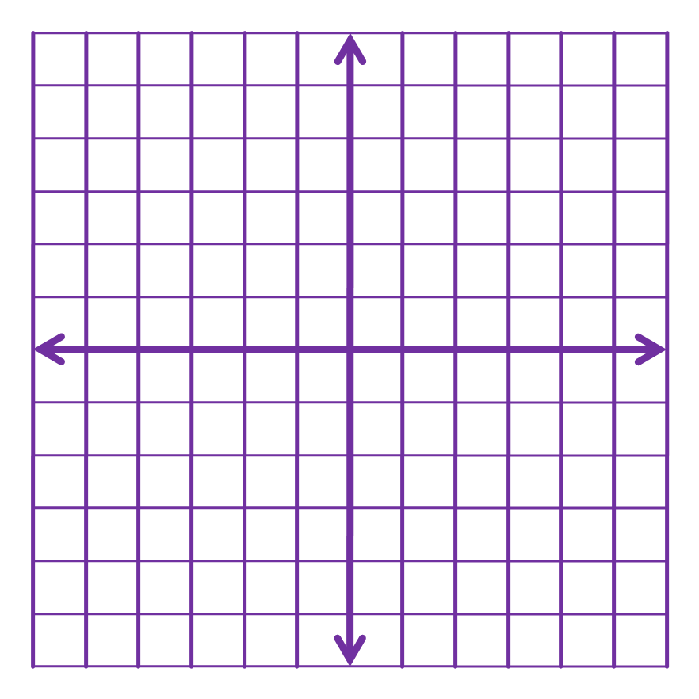
2.1 Represent Relations and Functions
Graph the equation y = 3x – 2
x y
-3 -11
-2 -8
-1 -5
0 -2
1 1
2 4
3 7
Notes:
x | y
-3 | -11
-2 | -8
-1 | -5
0 | -2
1 | 1
2 | 4
3 | 7

Slide 8
2.1 Represent Relations and Functions
Linear function
  Can be written in form y = mx + b
  Graphs a line
  y = 2x – 3
Functional notation
  Replace the y with f(x)
  Name
  Variable value
Notes:
Point out that functions can be named more than just f

Slide 9
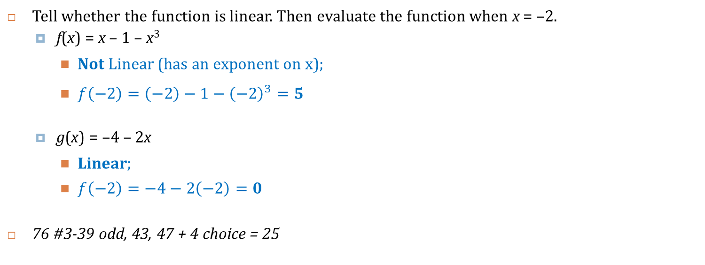
2.1 Represent Relations and Functions
Tell whether the function is linear. Then evaluate the function when x = –2.
  f(x) = x – 1 – x³
    Not Linear (has an exponent on x);
    $f\left(−2\right)=\left(−2\right)−1−{\left(−2\right)}^{3}=5$
  g(x) = –4 – 2x
    Linear;
    $f\left(−2\right)=−4−2\left(−2\right)=0$
76 #3-39 odd, 43, 47 + 4 choice = 25
Notes:
Not Linear (has an exponent on x);
$$f\left(−2\right)=\left(−2\right)−1−{\left(−2\right)}^{3}=5$$
Linear;
$$f\left(−2\right)=−4−2\left(−2\right)=0$$

Slide 10
Homework Quiz
2.1 Homework Quiz

Slide 11
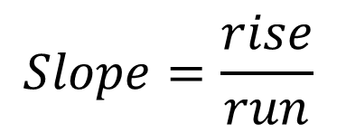
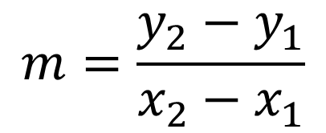
2.2 Find Slope and Rate of Change
$$Slope=\frac{rise}{run}$$
(x₂, y₂)
rise
$$m=\frac{y_{2}−y_{1}}{x_{2}−x_{1}}$$
(x₁, y₁)
run
Slope is the rate of change

Slide 12
2.2 Find Slope and Rate of Change
Positive Slope
  Rises
Zero Slope
  Horizontal
Negative Slope
  Falls
No Slope (Undefined)
  Vertical
0
+
–
No
There’s No Slope to stand on.

Slide 13
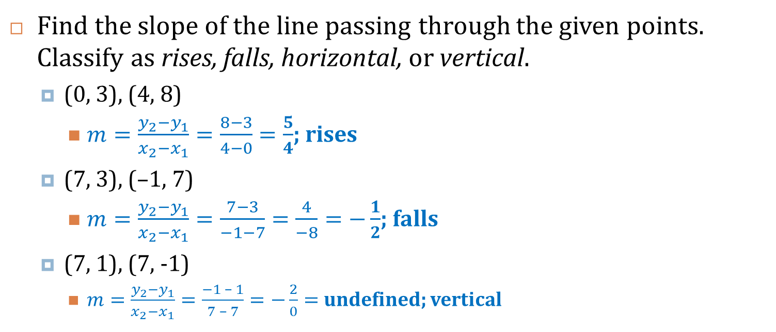
2.2 Find Slope and Rate of Change
Find the slope of the line passing through the given points. Classify as rises, falls, horizontal, or vertical.
  (0, 3), (4, 8)
    $m=\frac{y_{2}−y_{1}}{x_{2}−x_{1}}=\frac{8−3}{4−0}=\frac{5}{4}$; rises
  (7, 3), (–1, 7)
    $m=\frac{y_{2}−y_{1}}{x_{2}−x_{1}}=\frac{7−3}{−1−7}=\frac{4}{−8}=−\frac{1}{2}$; falls
  (7, 1), (7, -1)
    $m=\frac{y_{2}−y_{1}}{x_{2}−x_{1}}=\frac{−1 – 1}{7 – 7}=−\frac{2}{0}=$ undefined; vertical
Notes:
$m=\frac{y_{2}−y_{1}}{x_{2}−x_{1}}=\frac{8−3}{4−0}=\frac{5}{4}$; rises
$m=\frac{y_{2}−y_{1}}{x_{2}−x_{1}}=\frac{7−3}{−1−7}=\frac{4}{−8}=−\frac{1}{2}$; falls
$m=\frac{y_{2}−y_{1}}{x_{2}−x_{1}}=\frac{−1 – 1}{7 – 7}=−\frac{2}{0}=$ undefined; vertical

Slide 14
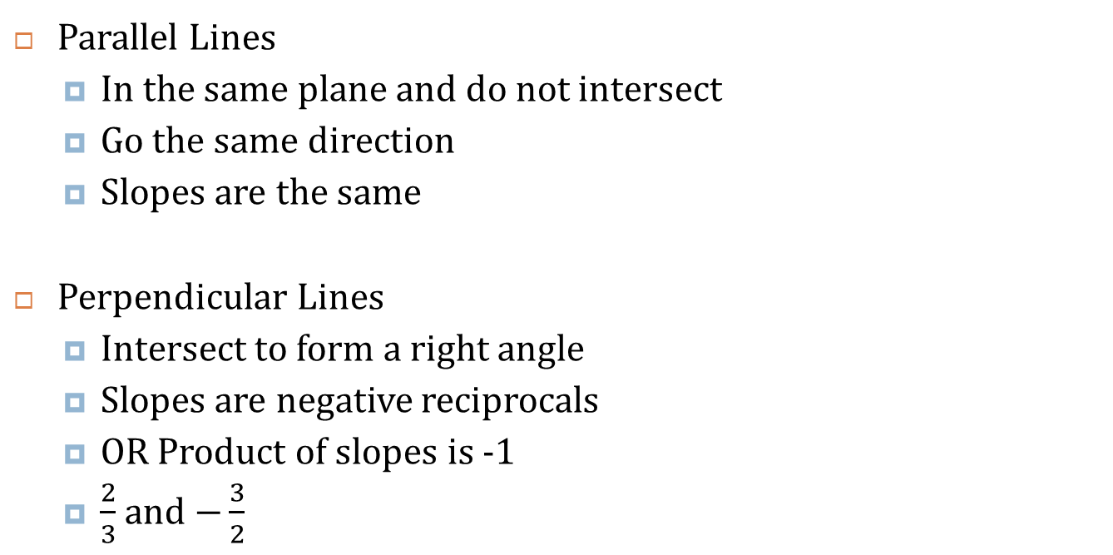
2.2 Find Slope and Rate of Change
Parallel Lines
  In the same plane and do not intersect
  Go the same direction
  Slopes are the same
Perpendicular Lines
  Intersect to form a right angle
  Slopes are negative reciprocals
  OR Product of slopes is -1
  $\frac{2}{3}$ and $−\frac{3}{2}$

Slide 15
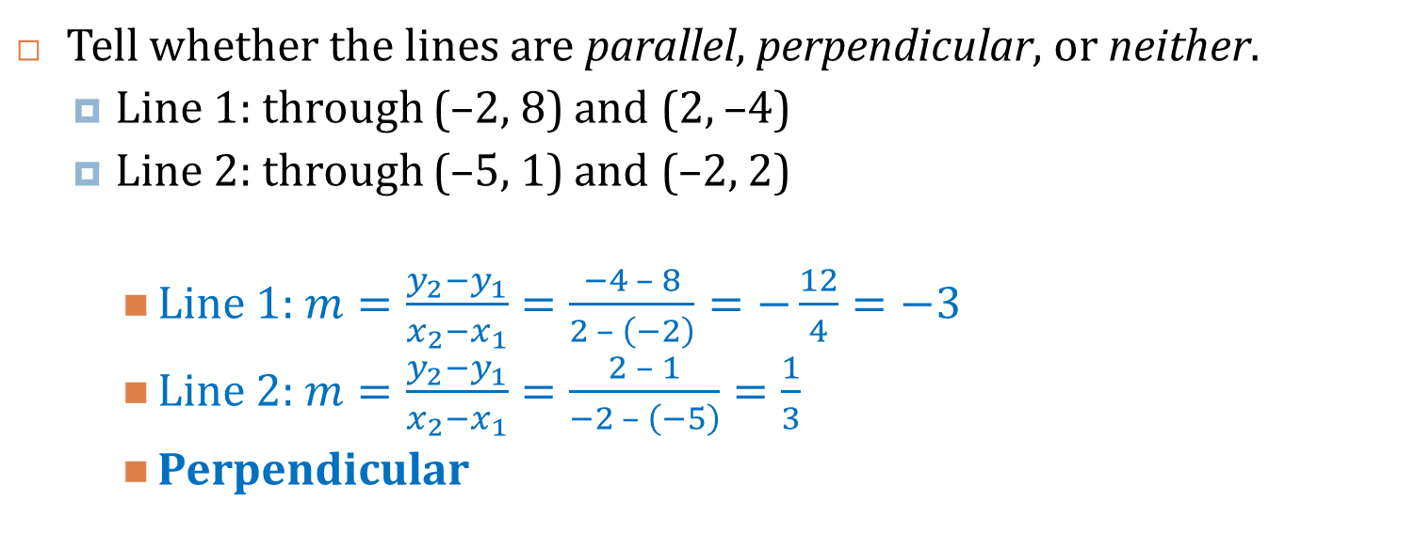
2.2 Find Slope and Rate of Change
Tell whether the lines are parallel, perpendicular, or neither.
  Line 1: through (–2, 8) and (2, –4)
  Line 2: through (–5, 1) and (–2, 2)
    Line 1: $m=\frac{y_{2}−y_{1}}{x_{2}−x_{1}}=\frac{−4 – 8}{2 – \left(−2\right)}=−\frac{12}{4}=−3$
    Line 2: $m=\frac{y_{2}−y_{1}}{x_{2}−x_{1}}=\frac{2 – 1}{−2 – \left(−5\right)}=\frac{1}{3}$
    Perpendicular
Notes:
Line 1: $m=\frac{y_{2}−y_{1}}{x_{2}−x_{1}}=\frac{−4 – 8}{2 – \left(−2\right)}=−\frac{12}{4}=−3$
Line 2: $m=\frac{y_{2}−y_{1}}{x_{2}−x_{1}}=\frac{2 – 1}{−2 – \left(−5\right)}=\frac{1}{3}$
Perpendicular

Slide 16
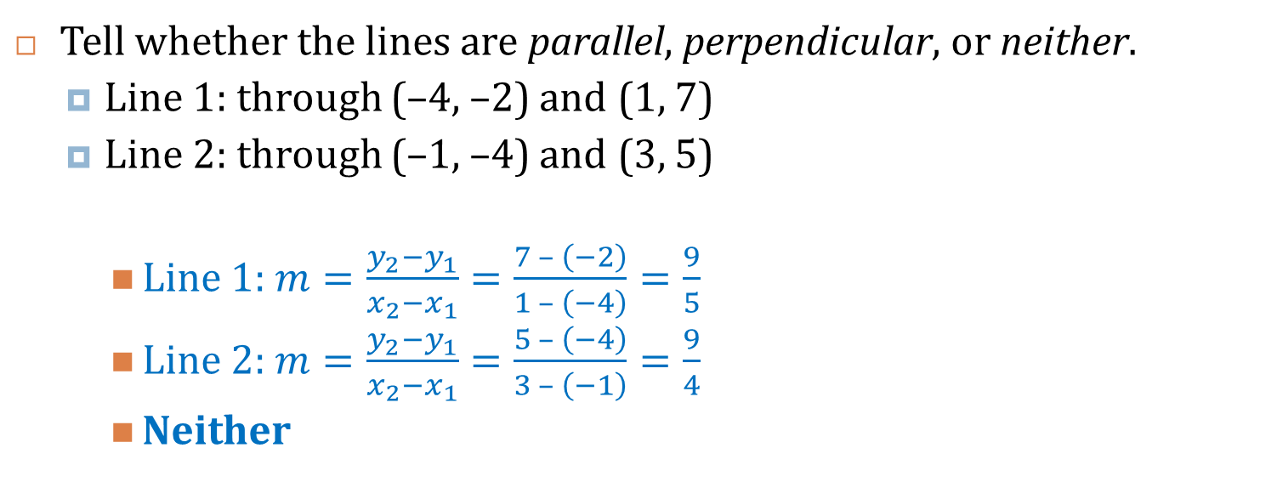
2.2 Find Slope and Rate of Change
Tell whether the lines are parallel, perpendicular, or neither.
  Line 1: through (–4, –2) and (1, 7)
  Line 2: through (–1, –4) and (3, 5)
    Line 1: $m=\frac{y_{2}−y_{1}}{x_{2}−x_{1}}=\frac{7 – \left(−2\right)}{1 – \left(−4\right)}=\frac{9}{5}$
    Line 2: $m=\frac{y_{2}−y_{1}}{x_{2}−x_{1}}=\frac{5 – \left(−4\right)}{3 – \left(−1\right)}=\frac{9}{4}$
    Neither
Notes:
Line 1: $m=\frac{y_{2}−y_{1}}{x_{2}−x_{1}}=\frac{7 – \left(−2\right)}{1 – \left(−4\right)}=\frac{9}{5}$
Line 2: $m=\frac{y_{2}−y_{1}}{x_{2}−x_{1}}=\frac{5 – \left(−4\right)}{3 – \left(−1\right)}=\frac{9}{4}$
Neither

Slide 17
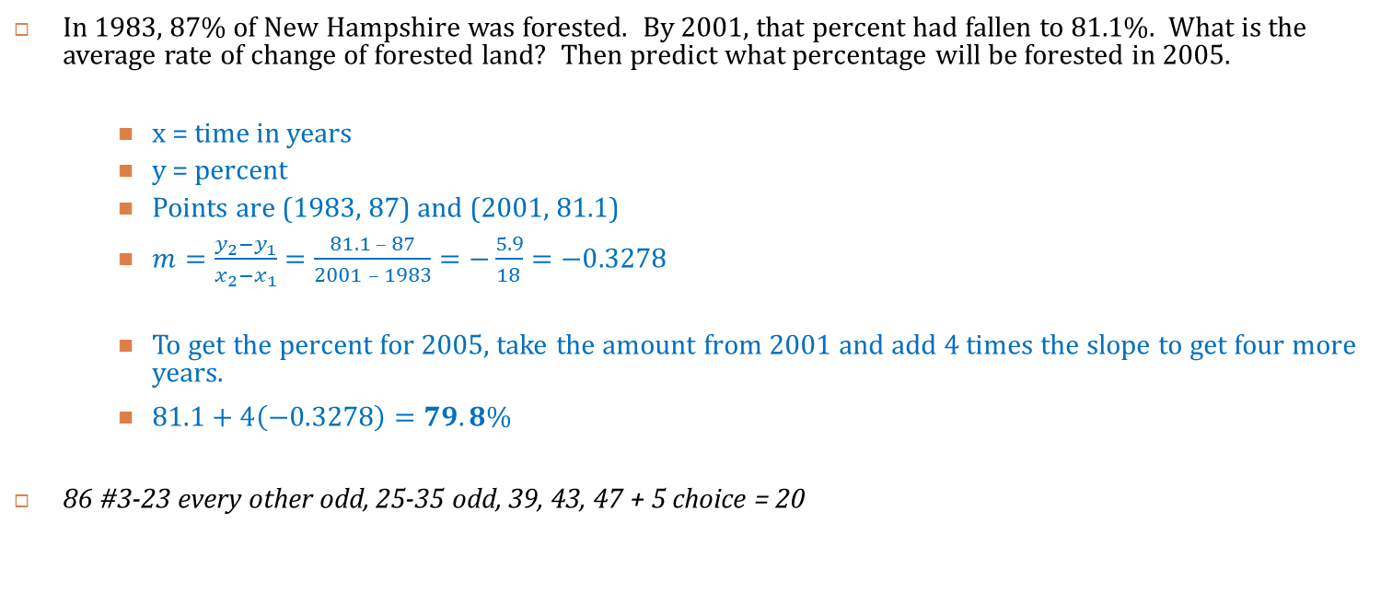
2.2 Find Slope and Rate of Change
In 1983, 87% of New Hampshire was forested. By 2001, that percent had fallen to 81.1%. What is the average rate of change of forested land? Then predict what percentage will be forested in 2005.
    x = time in years
    y = percent
    Points are (1983, 87) and (2001, 81.1)
    $m=\frac{y_{2}−y_{1}}{x_{2}−x_{1}}=\frac{81.1 – 87}{2001 – 1983}=−\frac{5.9}{18}=−0.3278$
    To get the percent for 2005, take the amount from 2001 and add 4 times the slope to get four more years.
    $81.1+4\left(−0.3278\right)=79.8\%$
86 #3-23 every other odd, 25-35 odd, 39, 43, 47 + 5 choice = 20
Notes:
x = time in years
y = percent
Points are (1983, 87) and (2001, 81.1)
$$m=\frac{y_{2}−y_{1}}{x_{2}−x_{1}}=\frac{81.1 – 87}{2001 – 1983}=−\frac{5.9}{18}=−0.3278$$
To get the percent for 2005, take the amount from 2001 and add 4 times the slope to get four more years.
$$81.1 + 4(−0.3278) = 79.8\%$$

Slide 18
Homework Quiz
2.2 Homework Quiz

Slide 19
2.3 Graph Equations of Lines
Slope-intercept form
  y = mx + b
    m is slope
    b is y-intercept
To graph
  Solve equation for y
  Plot the y-intercept
  From there move up and over the slope to find another couple of points
  Draw a line neatly through the points
Notes:
y-intercept is where the line crosses the y-axis

Slide 20

2.3 Graph Equations of Lines
Graph
  y = -2x
    $y=−2x+0$
    $m=−2=−\frac{2}{1}; b=0$
  y = x – 3
    $y=x−3$
    $m=1=\frac{1}{1};b=−3$
  f(x) = 2 – x
    $f\left(x\right)=2−x$
    $f\left(x\right)=−x+2$
    $m=−1=−\frac{1}{1};b=2$
Notes:
$$y=−2x+0$$
$$m=−2=−\frac{2}{1}; b=0$$
$$y=x−3$$
$$m=1=\frac{1}{1};b=−3$$
$$f\left(x\right)=2−x$$
$$f\left(x\right)=−x+2$$
$$m=−1=−\frac{1}{1};b=2$$

Slide 21

2.3 Graph Equations of Lines
Standard Form
  Ax + By = C
    A, B, and C are integers
To graph
  Find the x- and y-intercepts by letting the other variable = 0
  Plot the two points
  Draw a line through the two points
x-intercept:
Ax + B(0) = C
Ax = C
$x=\frac{C}{A}$
y-intercept:
A(0) + By = C
By = C
$y=\frac{C}{B}$

Slide 22
2.3 Graph Equations of Lines
Horizontal Lines
  y = c
Vertical Lines
  x = c

Slide 23
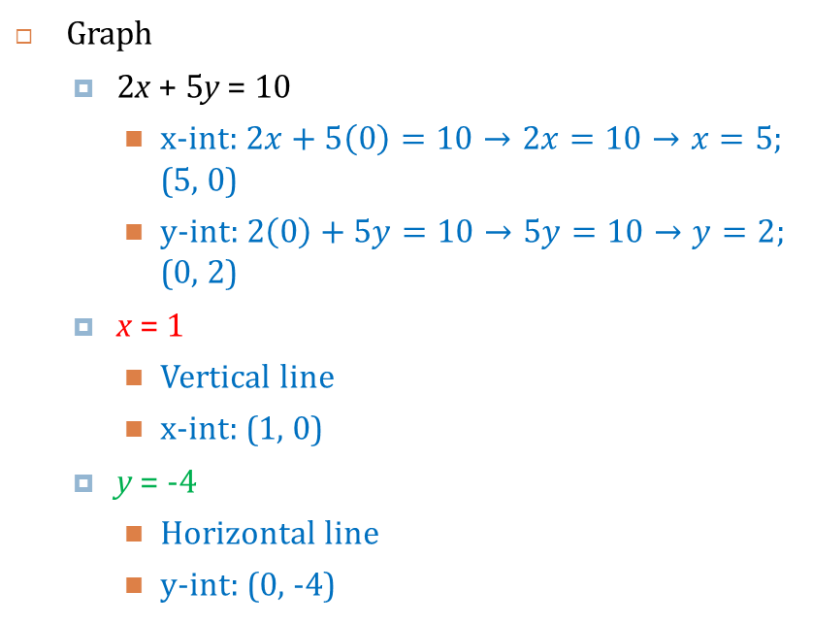
2.3 Graph Equations of Lines
Graph
  2x + 5y = 10
    x-int: $2x+5\left(0\right)=10→2x=10→x=5$; (5, 0)
    y-int: $2\left(0\right)+5y=10→5y=10→y=2$; (0, 2)
  x = 1
    Vertical line
    x-int: (1, 0)
  y = -4
    Horizontal line
    y-int: (0, -4)
Notes:
x-int: $2x+5\left(0\right)=10→2x=10→x=5$; (5, 0)
y-int: $2\left(0\right)+5y=10→5y=10→y=2$; (0, 2)
Vertical line
x-int: (1, 0)
Horizontal line
y-int: (0, -4)

Slide 24
2.3 Graph Equations of Lines
93 #1-69 every other odd + 2 choice = 20

Slide 25
Homework Quiz
2.3 Homework Quiz

Slide 26
2.4 Write Equations of Lines
Given slope and y-intercept
  Use slope-intercept form y = mx + b
Any other line
  Find the slope (m)
  Find a point the line goes through (x₁, y₁)
  Use point-slope form y – y₁ = m(x – x₁)

Slide 27
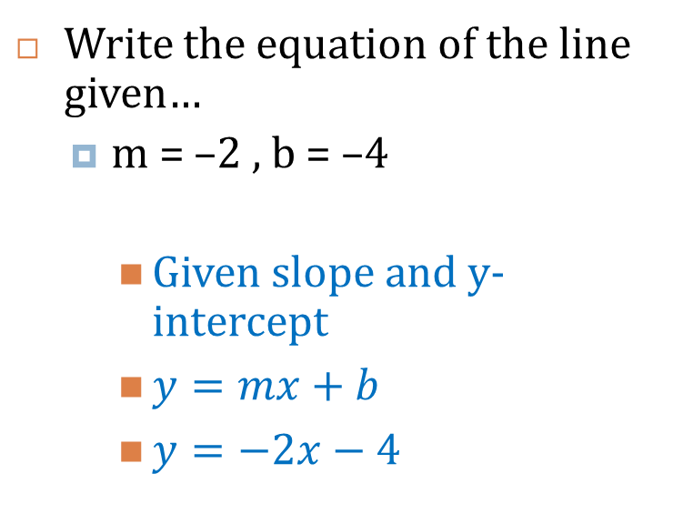
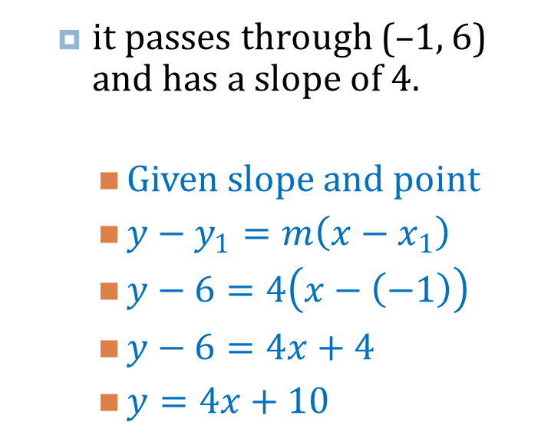
2.4 Write Equations of Lines
Write the equation of the line given…
  m = –2 , b = –4
    Given slope and y-intercept
    $y=mx+b$
    $y=−2x−4$
  it passes through (–1, 6) and has a slope of 4.
    Given slope and point
    $y−y_{1}=m\left(x−x_{1}\right)$
    $y−6=4\left(x−\left(−1\right)\right)$
    $y−6=4x+4$
    $y=4x+10$
Notes:
Given slope and y-intercept
$$y=mx+b$$
$$y=−2x−4$$
Given slope and point
$$y−y_{1}=m\left(x−x_{1}\right)$$
$$y−6=4\left(x−\left(−1\right)\right)$$
$$y−6=4x+4$$
$$y=4x+10$$

Slide 28
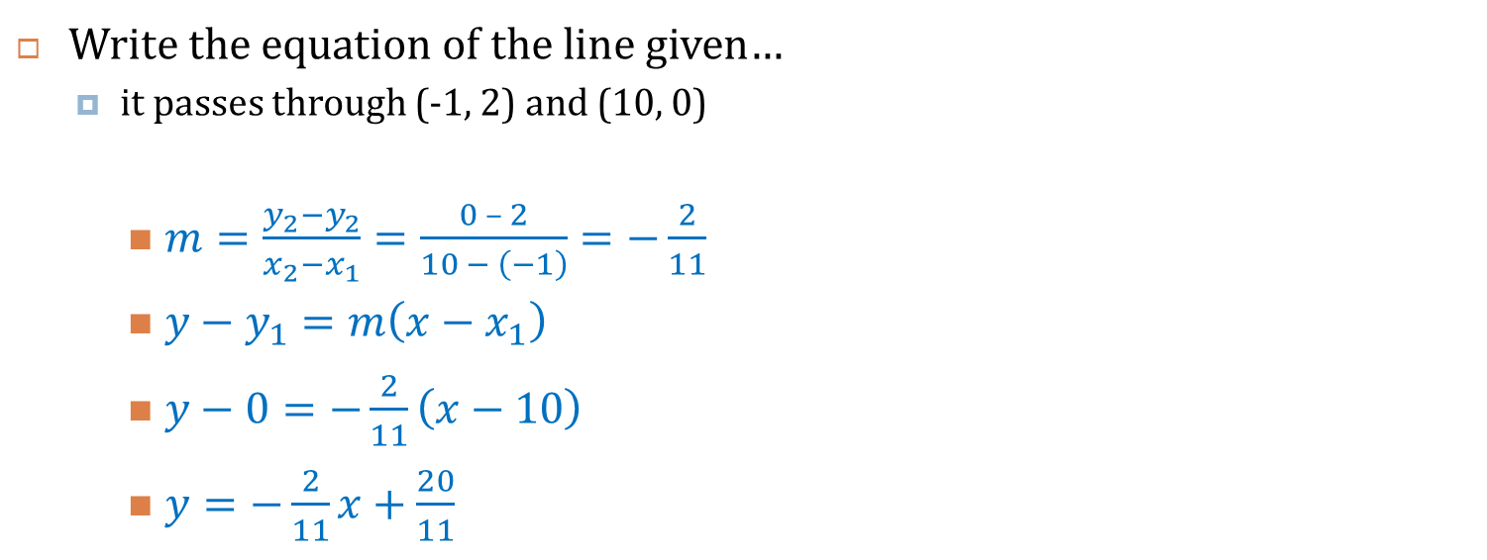
2.4 Write Equations of Lines
Write the equation of the line given…
  it passes through (-1, 2) and (10, 0)
    $m=\frac{y_{2}−y_{2}}{x_{2}−x_{1}}=\frac{0 – 2}{10 − \left(−1\right)}=−\frac{2}{11}$
    $y−y_{1}=m\left(x−x_{1}\right)$
    $y−0=−\frac{2}{11}\left(x−10\right)$
    $y=−\frac{2}{11}x+\frac{20}{11}$
Notes:
$$m=\frac{y_{2}−y_{2}}{x_{2}−x_{1}}=\frac{0 – 2}{10 − \left(−1\right)}=−\frac{2}{11}$$
$$y−y_{1}=m\left(x−x_{1}\right)$$
$$y−0=−\frac{2}{11}\left(x−10\right)$$
$$y=−\frac{2}{11}x+\frac{20}{11}$$

Slide 29

2.4 Write Equations of Lines
Write an equation of the line that passes through (4, –2) and is (a) parallel to, and (b) perpendicular to, the line y = 3x – 1.
    a) $m=3$; Parallel lines have same slope
    $$y−y_{1}=m\left(x−x_{1}\right)$$
    $$y−\left(−2\right)=3\left(x−4\right)$$
    $$y+2=3x−12$$
    $$y=3x−14$$
    b) $m=−\frac{1}{3}$; Perpendicular lines have negative reciprocal slopes
    $$y−y_{1}=m\left(x−x_{1}\right)$$
    $$y−\left(−2\right)=−\frac{1}{3}\left(x−4\right)$$
    $$y+2=−\frac{1}{3}x+\frac{4}{3}$$
    $$y=−\frac{1}{3}x−\frac{2}{3}$$
Notes:
a) $m=3$; Parallel lines have same slope
$$y−y_{1}=m\left(x−x_{1}\right)$$
$$y−\left(−2\right)=3\left(x−4\right)$$
$$y+2=3x−12$$
$$y=3x−14$$
b) $m=−\frac{1}{3}$; Perpendicular lines have negative reciprocal slopes
$$y−y_{1}=m\left(x−x_{1}\right)$$
$$y−\left(−2\right)=−\frac{1}{3}\left(x−4\right)$$
$$y+2=−\frac{1}{3}x+\frac{4}{3}$$
$$y=−\frac{1}{3}x−\frac{2}{3}$$

Slide 30
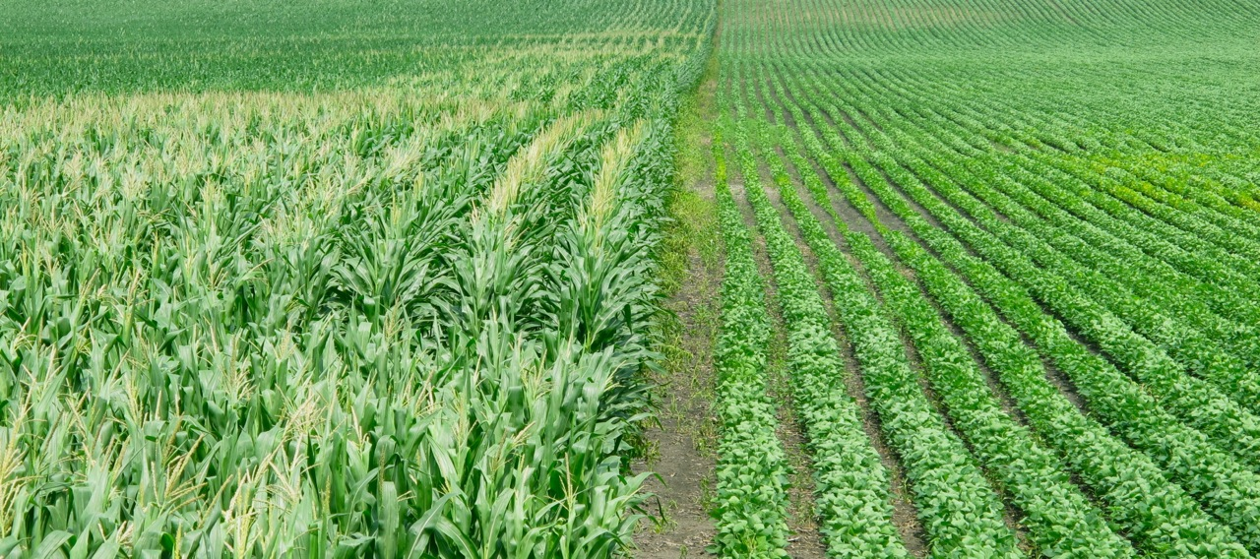
2.4 Write Equations of Lines
A certain farmer can harvest 44000 bushels of crops in a season. Corn averages 155 bushels per acre and soybeans average 44 bushels per acre in Michigan in 2013. Write an equation that models this situation.
The “per” means this rate
problem.
Rate × amount = total
155x + 44y = 44000
Notes:
The “per” means this rate problem. Rate × amount = total
155x + 44y = 44000

Slide 31
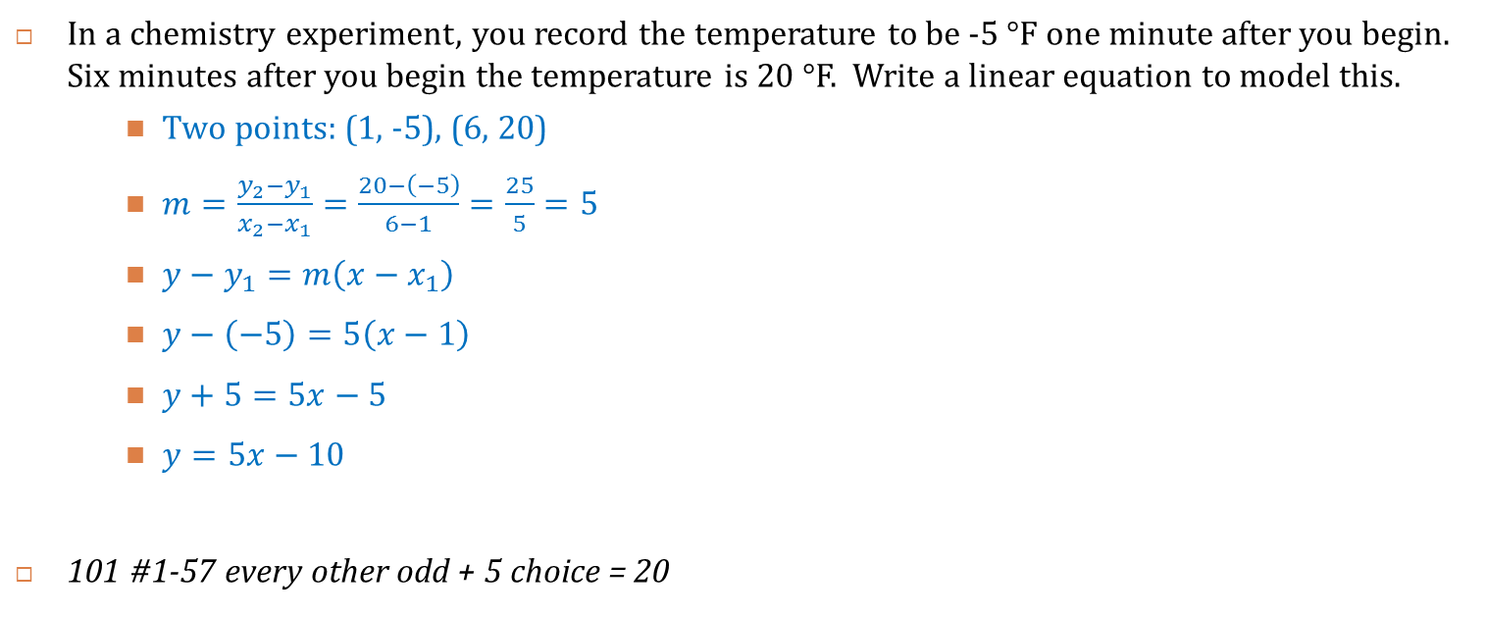
2.4 Write Equations of Lines
In a chemistry experiment, you record the temperature to be -5 °F one minute after you begin. Six minutes after you begin the temperature is 20 °F. Write a linear equation to model this.
    Two points: (1, -5), (6, 20)
    $m=\frac{y_{2}−y_{1}}{x_{2}−x_{1}}=\frac{20−\left(−5\right)}{6−1}=\frac{25}{5}=5$
    $y−y_{1}=m\left(x−x_{1}\right)$
    $y−\left(−5\right)=5\left(x−1\right)$
    $y+5=5x−5$
    $y=5x−10$
101 #1-57 every other odd + 5 choice = 20
Notes:
Two points: (1, -5), (6, 20)
$$m=\frac{y_{2}−y_{1}}{x_{2}−x_{1}}=\frac{20−\left(−5\right)}{6−1}=\frac{25}{5}=5$$
$$y−y_{1}=m\left(x−x_{1}\right)$$
$$y−\left(−5\right)=5\left(x−1\right)$$
$$y+5=5x−5$$
$$y=5x−10$$

Slide 32
Homework Quiz
2.4 Homework Quiz

Slide 33
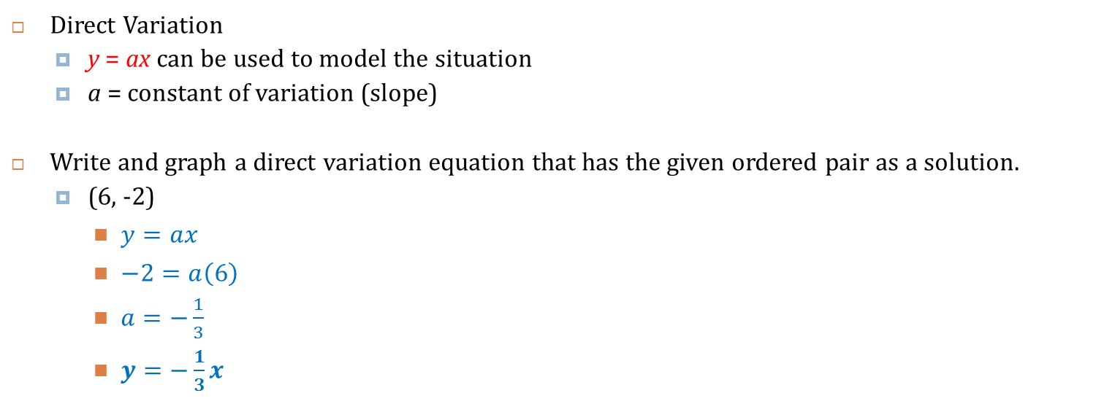
2.5 Model Direct Variation
Direct Variation
  y = ax can be used to model the situation
  a = constant of variation (slope)
Write and graph a direct variation equation that has the given ordered pair as a solution.
  (6, -2)
    $y=ax$
    $−2=a\left(6\right)$
    $a=−\frac{1}{3}$
    $y=−\frac{1}{3}x$
Notes:
Slope is $\left(−\frac{2}{6}\right)=−\frac{1}{3}$
$$y=−\frac{1}{3}x$$

Slide 34
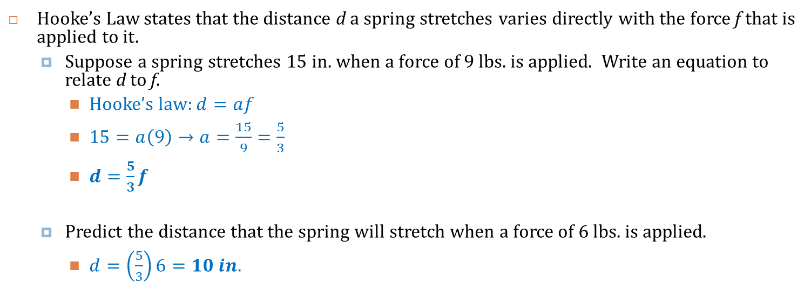
2.5 Model Direct Variation
Hooke’s Law states that the distance d a spring stretches varies directly with the force f that is applied to it.
  Suppose a spring stretches 15 in. when a force of 9 lbs. is applied. Write an equation to relate d to f.
    Hooke’s law: $d=af$
    $15=a\left(9\right)→a=\frac{15}{9}=\frac{5}{3}$
    $d=\frac{5}{3}f$
  Predict the distance that the spring will stretch when a force of 6 lbs. is applied.
    $d=\left(\frac{5}{3}\right)6=10 in.$
Notes:
Hooke’s law: d = af
15 = a(9) → a = 15/9 = 5/3
d = 5/3 f
d = (5/3) 6 = 10 in.

Slide 35
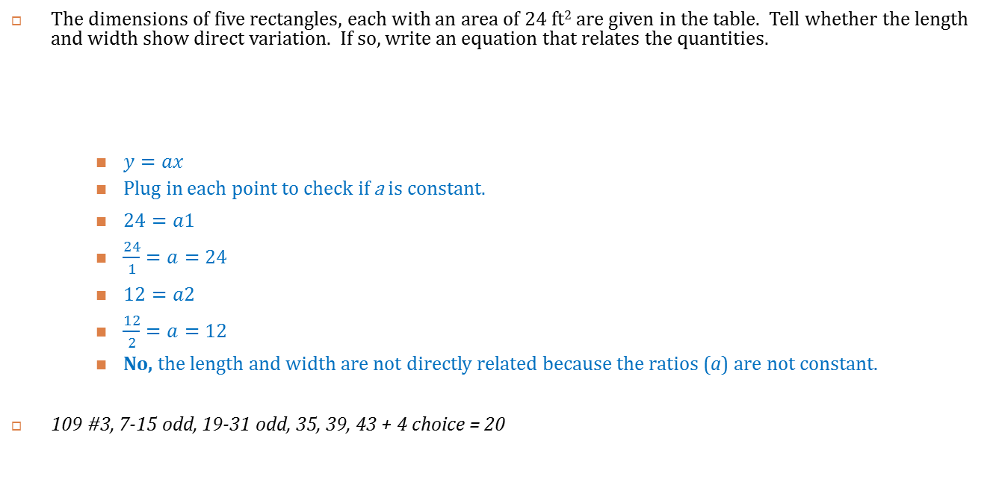
2.5 Model Direct Variation
The dimensions of five rectangles, each with an area of 24 ft² are given in the table. Tell whether the length and width show direct variation. If so, write an equation that relates the quantities.
    $y=ax$
    Plug in each point to check if a is constant.
    $24=a1$
    $\frac{24}{1}=a=24$
    $12=a2$
    $\frac{12}{2}=a=12$
    No, the length and width are not directly related because the ratios (a) are not constant.
109 #3, 7-15 odd, 19-31 odd, 35, 39, 43 + 4 choice = 20
Length, x | 1 | 2 | 3 | 4 | 5
Width, y | 24 | 12 | 8 | 6 | 4.8
Notes:
$$y=ax$$
Plug in each point to check if a is constant.
$$24=a1$$
$$\frac{24}{1}=a=24$$
$$12=a2$$
$$\frac{12}{2}=a=12$$
No, the length and width are not directly related because the ratios (a) are not constant.

Slide 36
Homework Quiz
2.5 Homework Quiz

Slide 37
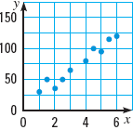
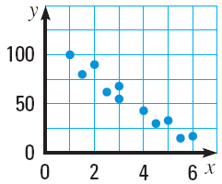
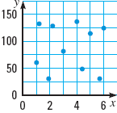
2.6 Draw Scatter Plots and Best-Fitting Lines
Scatter Plot
  Graph of many data points
Positive Correlation
  The slope of the scatter plot tends to be positive
Negative Correlation
  The slope of the scatter plot tends to be negative
No Correlation
  There is no obvious pattern from the scatter plot

Slide 38
2.6 Draw Scatter Plots and Best-Fitting Lines
Correlation Coefficient (r)
  Number between -1 and 1 that measures how well the data fits a line.
  Positive for positive correlation, negative for negative
  r = 0 means there is no correlation

Slide 39
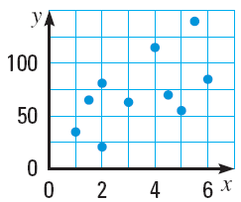
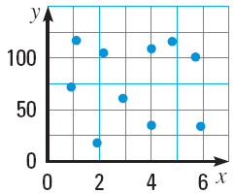
2.6 Draw Scatter Plots and Best-Fitting Lines
For each scatter plot, (a) tell whether the data have a positive correlation, a negative correlation, or approximately no correlation, and (b) tell whether the correlation coefficient is closest to –1, –0.5, 0, 0.5, or 1.
Positive, r ≈ 0.5
Negative, r ≈ -1
No correlation, r ≈ 0
Notes:
Positive, r ≈ 0.5
Negative, r ≈ -1
No correlation, r ≈ 0

Slide 40
2.6 Draw Scatter Plots and Best-Fitting Lines
Best-fitting line
  Line that most closely approximates the data
Find the best-fitting line
  Draw a scatter plot of the data
  Sketch the line that appears to follow the data the closest
    There should be about as many points below the line as above
  Choose two points on the line and find the equation of the line
    These do not have to be original data points
Notes:
See example 5 in the textbook to see how to do this on a TI graphing calculator

Slide 41
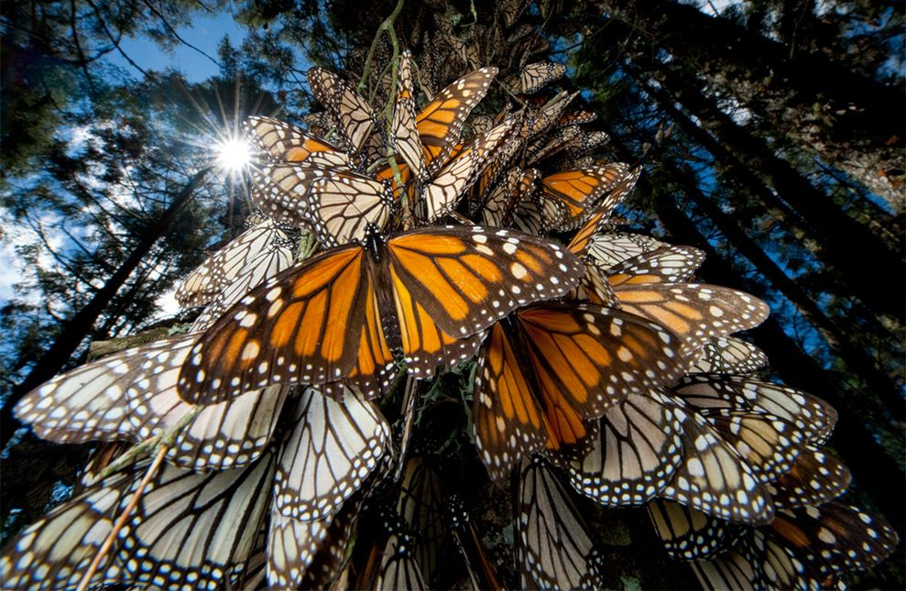
2.6 Draw Scatter Plots and Best-Fitting Lines
x | 0 | 1 | 2 | 3 | 4 | 5 | 6 | 7
y | 16.5 | 11.4 | 12.5 | 4.7 | 9.9 | 7.1 | 2.9 | 1.7
Monarch Butterflies: The table shows the area in Mexico used by Monarch Butterflies to spend winter, y, in acres x years after 2006.
  Approximate the best-fitting line for the data.
  Use your equation from part (a) to predict the area used by the butterflies in 2016.
Notes:
Sample Answer: $y=−1.89x+14.97$
Sample Answer:
$y=−1.89(10)+14.97=−3.93$acres (they would be gone, extinct!)

Slide 42
2.6 Draw Scatter Plots and Best-Fitting Lines
117 #1-29 odd + 5 choice = 20

Slide 43
Homework Quiz
2.6 Homework Quiz

Slide 44
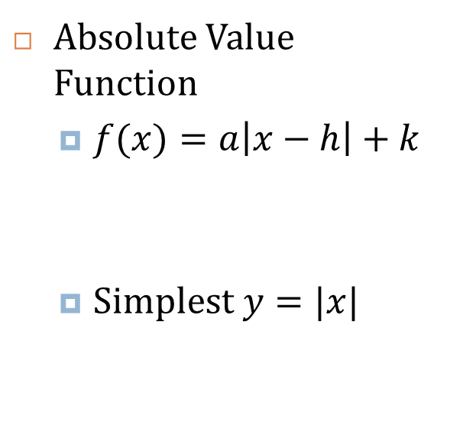
2.7 Use Absolute Value Functions and Transformations
Absolute Value Function
  $f(x)=a\left|x−h\right|+k$
  Simplest $y=|x|$
Slope of left is -1
Vertex
Slope of right is 1

Slide 45

2.7 Use Absolute Value Functions and Transformations
  $$f(x)=a\left|x−h\right|+k$$
Transformations (changes to graph’s size, shape, position, or orientation)
  Stretch/Shrink
    a is the factor the graph is stretched or shrunk vertically
    Multiply the y-coordinates by a
    Since the slope of the right side of the graph was 1, the new slope will be a
  Reflection → Flips the graph over a line
    If a is negative, the graph will be flipped over the x-axis
  Translation → moves graph
    h is how far graph moves to right
    k is how far graph moves up
    Since the vertex was (0, 0), the new vertex will be (h, k)
  Apply stretch/shrinks and reflections before translations
    Multiply before adding
Absolute value function only

Slide 46
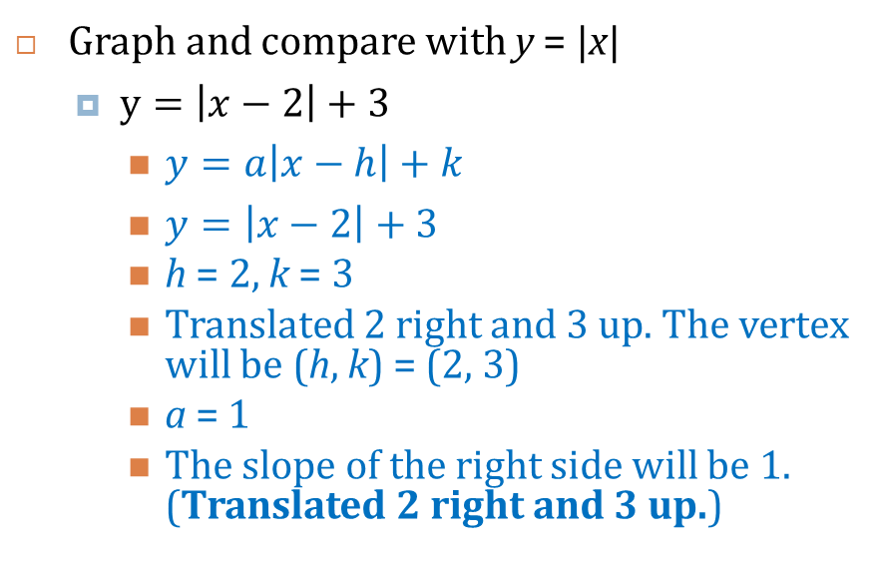
2.7 Use Absolute Value Functions and Transformations
Graph and compare with y = |x|
  $y=\left|x−2\right|+3$
    $y=a\left|x−h\right|+k$
    $y=\left|x−2\right|+3$
    h = 2, k = 3
    Translated 2 right and 3 up. The vertex will be (h, k) = (2, 3)
    a = 1
    The slope of the right side will be 1. (Translated 2 right and 3 up.)
Notes:
$$y=a\left|x−h\right|+k$$
$$y=\left|x−2\right|+3$$
h = 2, k = 3
Translated 2 right and 3 up. The vertex will be (h, k) = (2, 3)
a = 1
The slope of the right side will be 1. (Translated 2 right and 3 up.)

Slide 47
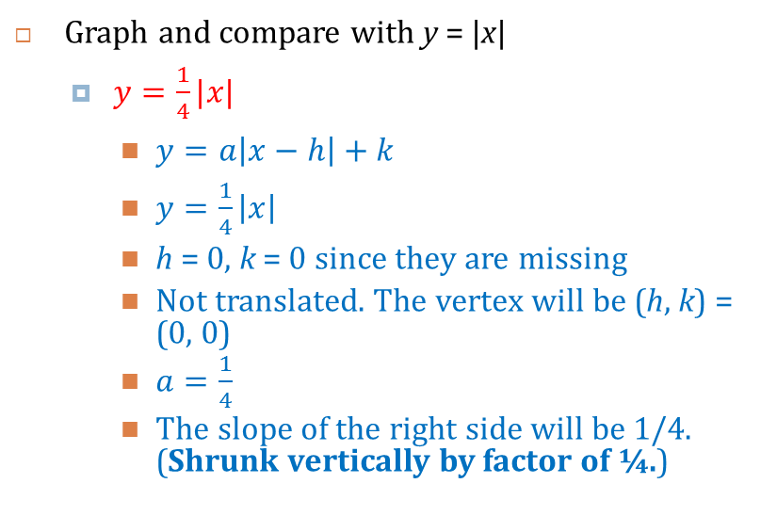
2.7 Use Absolute Value Functions and Transformations
Graph and compare with y = |x|
  $y=\frac{1}{4}|x|$
    $y=a\left|x−h\right|+k$
    $y=\frac{1}{4}\left|x\right|$
    h = 0, k = 0 since they are missing
    Not translated. The vertex will be (h, k) = (0, 0)
    $a=\frac{1}{4}$
    The slope of the right side will be 1/4. (Shrunk vertically by factor of ¼.)
Notes:
$$y=a\left|x−h\right|+k$$
$$y=\frac{1}{4}\left|x\right|$$
h = 0, k = 0 since they are missing
Not translated. The vertex will be (h, k) = (0, 0)
$a=\frac{1}{4}$
The slope of the right side will be 1/4. (Shrunk vertically by factor of ¼.)

Slide 48
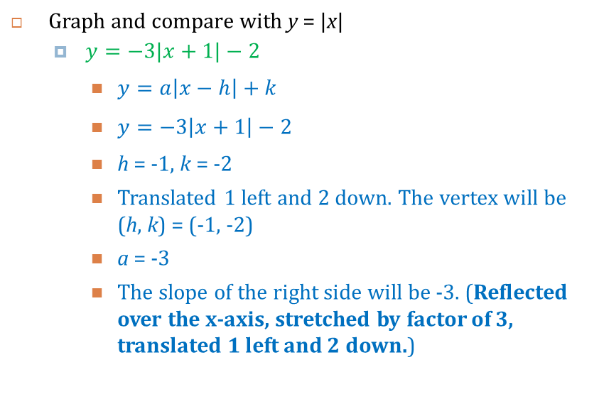
2.7 Use Absolute Value Functions and Transformations
Graph and compare with y = |x|
  $y=−3|x+1|−2$
    $y=a\left|x−h\right|+k$
    $y=−3\left|x+1\right|−2$
    h = -1, k = -2
    Translated 1 left and 2 down. The vertex will be (h, k) = (-1, -2)
    a = -3
    The slope of the right side will be -3. (Reflected over the x-axis, stretched by factor of 3, translated 1 left and 2 down.)
Notes:
$$y=a\left|x−h\right|+k$$
$$y=−3\left|x+1\right|−2$$
h = -1, k = -2
Translated 1 left and 2 down. The vertex will be (h, k) = (-1, -2)
a = -3
The slope of the right side will be -3. (Reflected over the x-axis, stretched by factor of 3, translated 1 left and 2 down.)

Slide 49
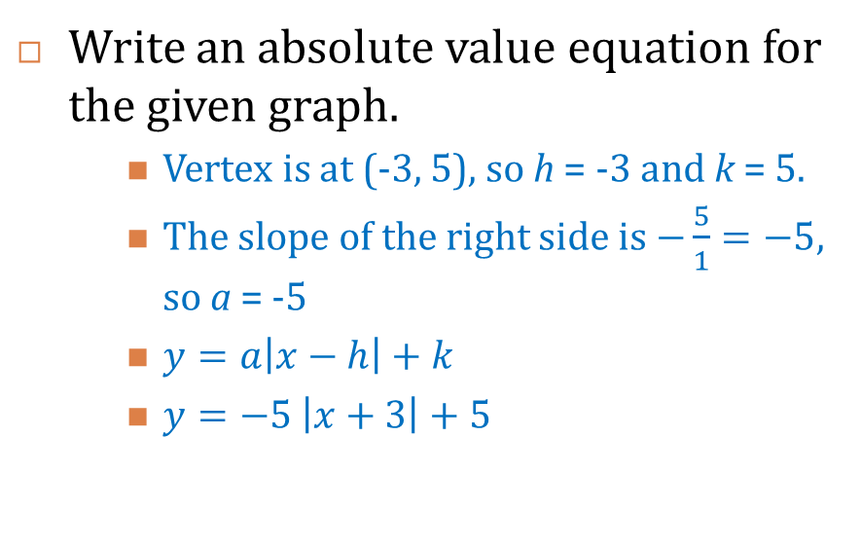
2.7 Use Absolute Value Functions and Transformations
Write an absolute value equation for the given graph.
    Vertex is at (-3, 5), so h = -3 and k = 5.
    The slope of the right side is $−\frac{5}{1}=−5$, so a = -5
    $y=a\left|x−h\right|+k$
    $y=−5 \left|x+3\right|+5$
Notes:
Vertex is at (-3, 5), so h = -3 and k = 5.
The slope of the right side is $−\frac{5}{1}=−5$, so a = -5
$$y=a\left|x−h\right|+k$$
$$y=−5 \left|x+3\right|+5$$

Slide 50
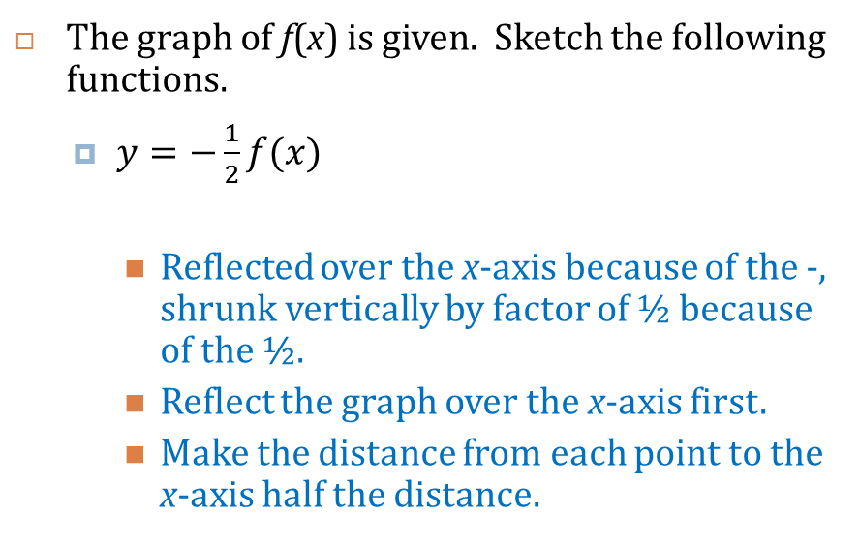
2.7 Use Absolute Value Functions and Transformations
The graph of f(x) is given. Sketch the following functions.
  $y=−\frac{1}{2}f(x)$
    Reflected over the x-axis because of the -, shrunk vertically by factor of ½ because of the ½.
    Reflect the graph over the x-axis first.
    Make the distance from each point to the x-axis half the distance.
Notes:
Reflected over the x-axis because of the -, shrunk vertically by factor of ½ because of the ½.
Reflect the graph over the x-axis first.
Make the distance from each point to the x-axis half the distance.

Slide 51
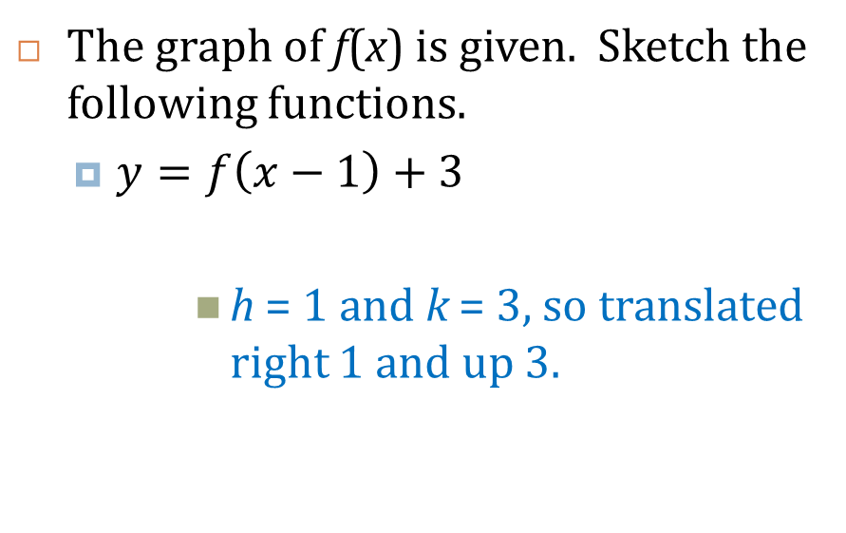
2.7 Use Absolute Value Functions and Transformations
The graph of f(x) is given. Sketch the following functions.
  $y=f\left(x−1\right)+3$
      h = 1 and k = 3, so translated right 1 and up 3.
Notes:
h = 1 and k = 3, so translated right 1 and up 3.

Slide 52
2.7 Use Absolute Value Functions and Transformations
127 #3-37 odd + 2 choice = 20

Slide 53
Homework Quiz
2.7 Homework Quiz

Slide 54
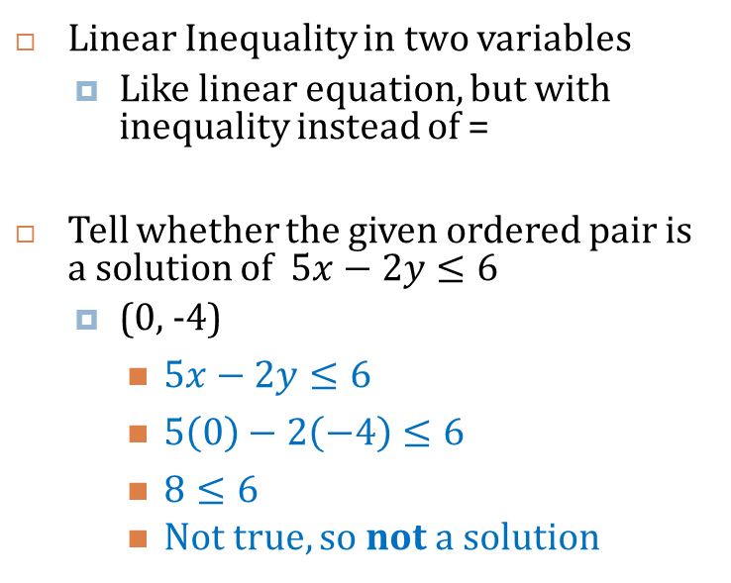
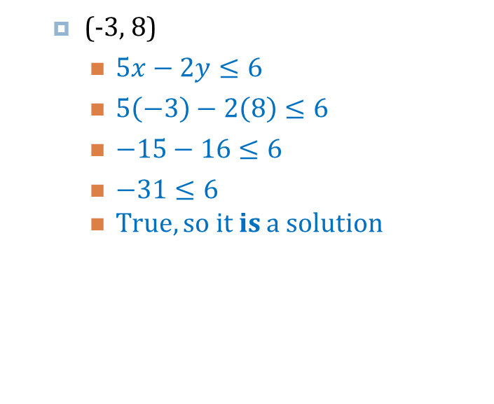
2.8 Graph Linear Inequalities in Two Variables
Linear Inequality in two variables
  Like linear equation, but with inequality instead of =
Tell whether the given ordered pair is a solution of $5x−2y≤6$
  (0, -4)
    $5x−2y≤6$
    $5\left(0\right)−2\left(−4\right)≤6$
    $8≤6$
    Not true, so not a solution
  (-3, 8)
    $5x−2y≤6$
    $5\left(−3\right)−2\left(8\right)≤6$
    $−15−16≤6$
    $−31≤6$
    True, so it is a solution
Notes:
$$5x−2y≤6$$
$$5\left(0\right)−2\left(−4\right)≤6$$
$$8≤6$$
Not true, so not a solution
$$5x−2y≤6$$
$$5\left(−3\right)−2\left(8\right)≤6$$
$$−15−16≤6$$
$$−31≤6$$
True, so it is a solution

Slide 55
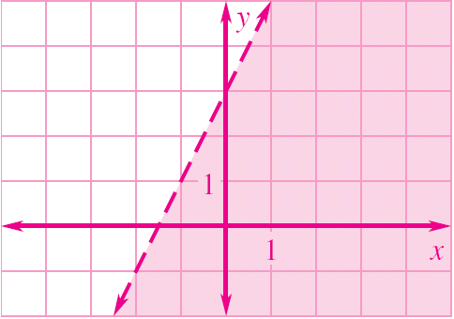
2.8 Graph Linear Inequalities in Two Variables
Graphing a linear inequality
  Graph the line as if it was =
  Dotted or Solid line
    Dotted if <, >
    Solid if ≤, =, ≥
  Shade
    Test a point not on the line
    If the point is a solution, shade that side of the line
    If the point is not a solution, shade the other side of the line

Slide 56
2.8 Graph Linear Inequalities in Two Variables
Graph
  x ≥ -4
    Graph the line: Vertical line at x = -4.
    Solid because equal to.
    Shade the right because that is where the x’s are bigger than -4.
Notes:
Graph the line: Vertical line at x = -4.
Solid because equal to.
Shade the right because that is where the x’s are bigger than -4.

Slide 57
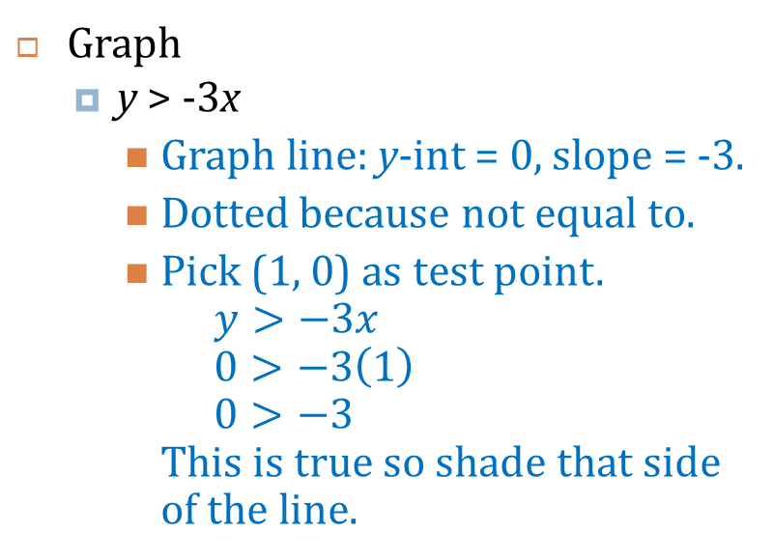
2.8 Graph Linear Inequalities in Two Variables
Graph
  y > -3x
    Graph line: y-int = 0, slope = -3.
    Dotted because not equal to.
    Pick (1, 0) as test point.
    $y>−3x$
    $0>−3\left(1\right)$
    $0>−3$
    This is true so shade that side of the line.
Notes:
Graph line: y-int = 0, slope = -3.
Dotted because not equal to.
Pick (1, 0) as test point. $y>−3x→0>−3\left(1\right)→0>−3$. This is true so shade that side of the line.

Slide 58
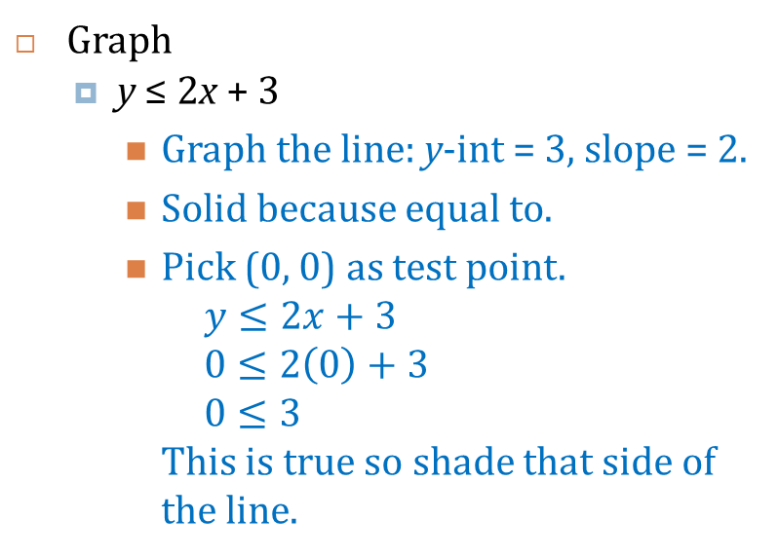
2.8 Graph Linear Inequalities in Two Variables
Graph
  y ≤ 2x + 3
    Graph the line: y-int = 3, slope = 2.
    Solid because equal to.
    Pick (0, 0) as test point.
    $y≤2x+3$
    $0≤2\left(0\right)+3$
    $0≤3$
    This is true so shade that side of the line.
Notes:
Graph the line: y-int = 3, slope = 2.
Solid because equal to.
Pick (0, 0) as test point. $y≤2x+3→0≤2\left(0\right)+3→0≤3$. This is true so shade that side of the line.

Slide 59
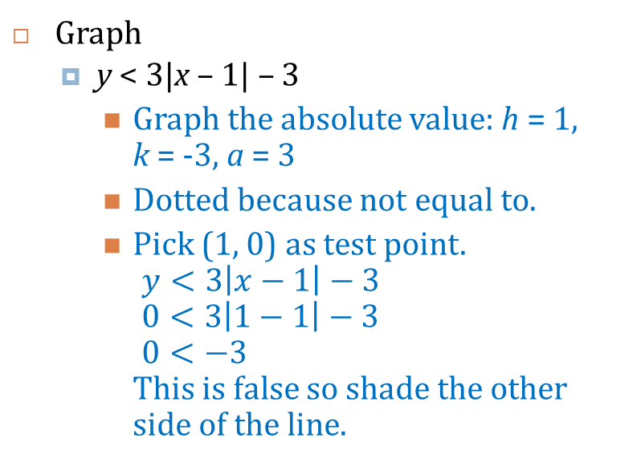
2.8 Graph Linear Inequalities in Two Variables
Graph
  y < 3|x – 1| – 3
    Graph the absolute value: h = 1, k = -3, a = 3
    Dotted because not equal to.
    Pick (1, 0) as test point.
    $y<3\left|x−1\right|−3$
    $0<3\left|1−1\right|−3$
    $0<−3$
    This is false so shade the other side of the line.
Notes:
Graph the absolute value: h = 1, k = -3, a = 3
Dotted because not equal to.
Pick (1, 0) as test point. $y<3\left|x−1\right|−3→0<3\left|1−1\right|−3→0<−3$. This is false so shade the other side of the line.

Slide 60
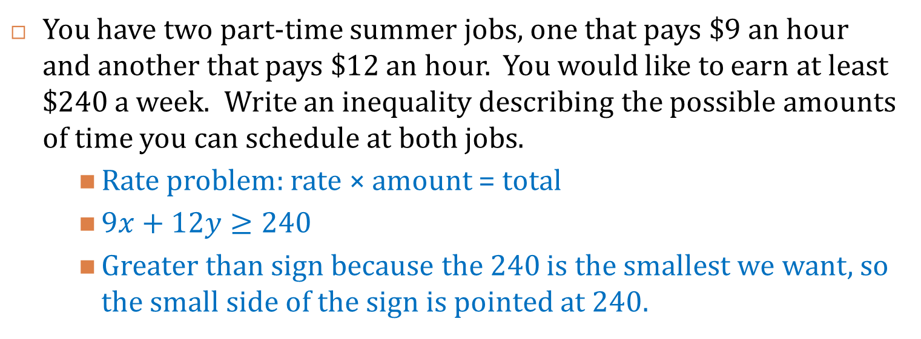
2.8 Graph Linear Inequalities in Two Variables
You have two part-time summer jobs, one that pays $9 an hour and another that pays $12 an hour. You would like to earn at least $240 a week. Write an inequality describing the possible amounts of time you can schedule at both jobs.
    Rate problem: rate × amount = total
    $9x+12y≥240$
    Greater than sign because the 240 is the smallest we want, so the small side of the sign is pointed at 240.
Notes:
Rate problem: rate × amount = total
$$9x+12y≥240$$
Greater than sign because the 240 is the smallest we want, so the small side of the sign is pointed at 240.

Slide 61
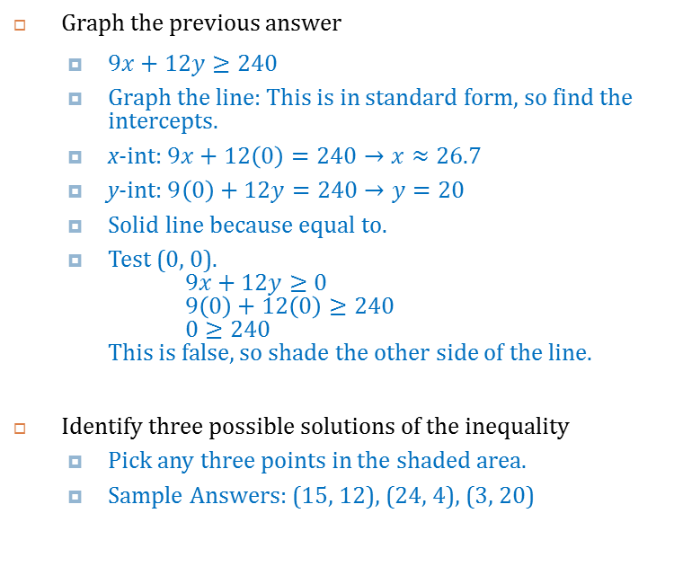
2.8 Graph Linear Inequalities in Two Variables
0 2 4 6 8 10 12 14 16 18 20 22 24
Graph the previous answer
  $9x+12y≥240$
  Graph the line: This is in standard form, so find the intercepts.
  x-int: $9x+12\left(0\right)=240→x≈26.7$
  y-int: $9\left(0\right)+12y=240→y=20$
  Solid line because equal to.
  Test (0, 0).
  $9x+12y≥0$
  $9\left(0\right)+12\left(0\right)≥240$
  $0≥240$
  This is false, so shade the other side of the line.
Identify three possible solutions of the inequality
  Pick any three points in the shaded area.
  Sample Answers: (15, 12), (24, 4), (3, 20)
0 3 6 9 12 15 18 21 24 27 30 33 36
Notes:
$$9x+12y≥240$$
Graph the line: This is in standard form, so find the intercepts.
x-int: $9x+12\left(0\right)=240→x≈26.7$
y-int: $9\left(0\right)+12y=240→y=20$
Solid line because equal to.
Test (0, 0). $9x+12y≥0→9\left(0\right)+12\left(0\right)≥240→0≥240$. This is false, so shade the other side of the line.
Pick any three points in the shaded area.
Sample Answers: (15, 12), (24, 4), (3, 20)

Slide 62
2.8 Graph Linear Inequalities in Two Variables
135 #5-37 odd, 41, 43 + 1 choice = 20

Slide 63
Homework Quiz
2.8 Homework Quiz

Slide 64
2.Review
145 #20 choice = 20

